Slide 1
Summer 2015 Update
Tom Kulczewski
Director of Buildings & Grounds
920-563-7808
TomK@fortschools.org
September 17, 2015

Slide 2
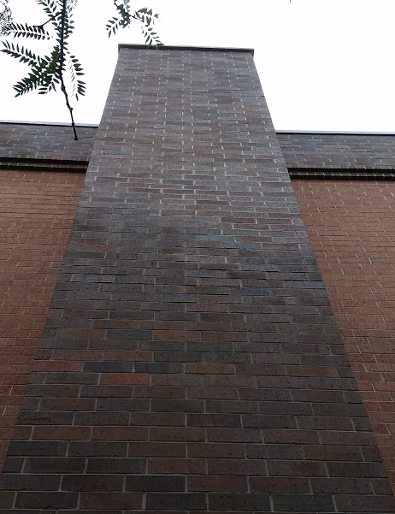
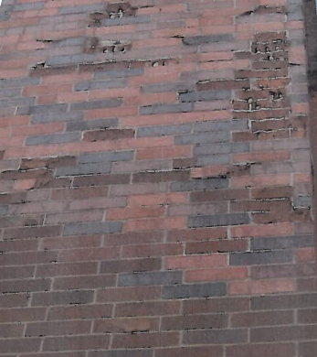
Summer 2015
Masonry Repair
Barrie and Rockwell

Slide 3
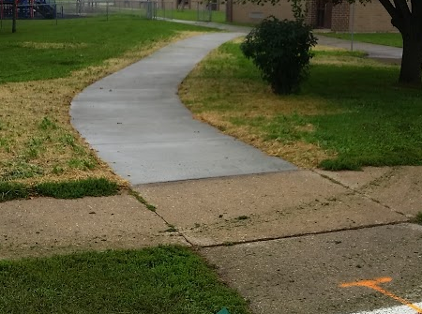
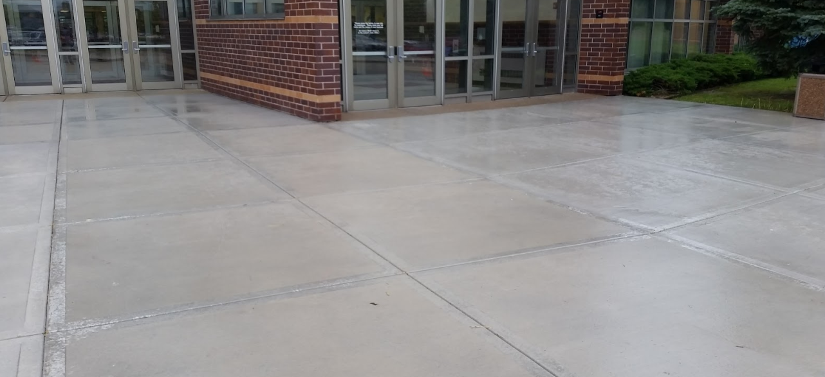
Summer 2015
Concrete
Entrance at High School
Safety Walk at Purdy

Slide 4
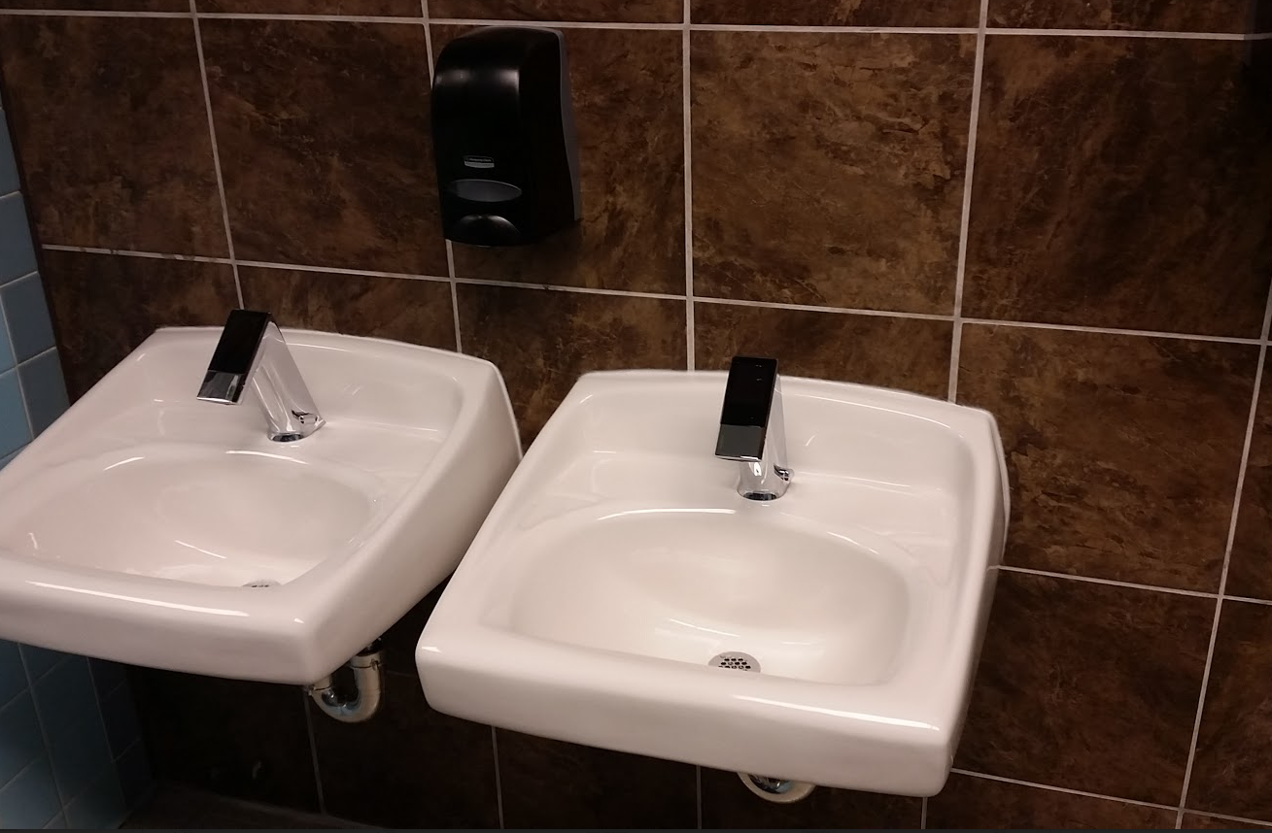
Summer 2015
Sinks
Rockwell / HS Commons

Slide 5
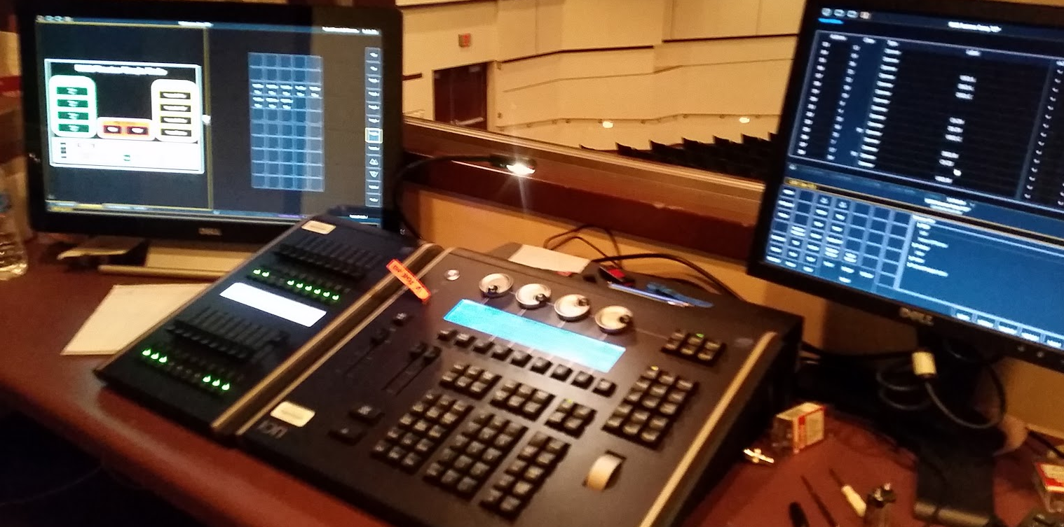
Summer 2015
High School
Re-lamp Competition Field
Replace Auditorium Lighting Controls

Slide 6
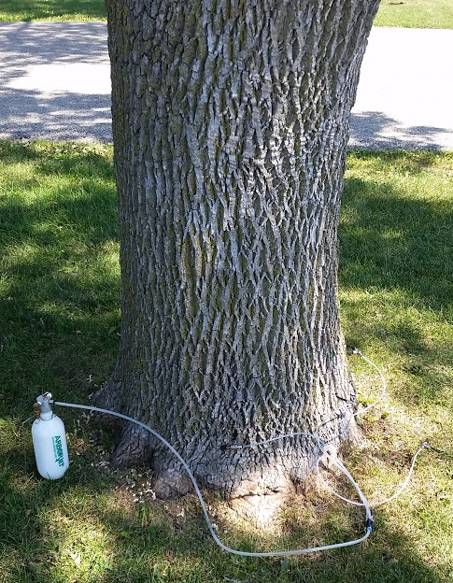
Summer 2015
Ash / At-Risk Trees
Removal completed
by August 28th

Slide 7
Summer 2015
Interior Lighting
Retrofit LED Bulbs in Existing Fixtures
HS Pool

Slide 8
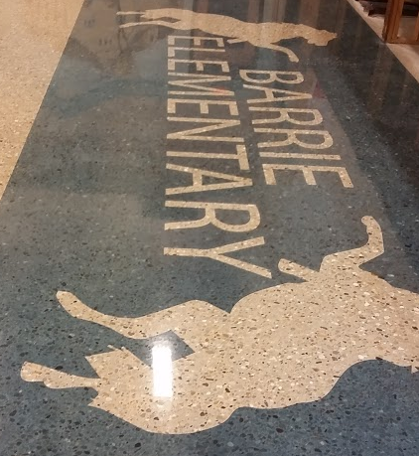
Summer 2015
Floor Replacement
Barrie Multipurpose Room
Remove Tile / Asbestos
Grind / Stain / Seal
Polished Concrete
No Wax / No Stripper / Clean with Water

Slide 9
July 20, 2015
Barrie Elementary 7:00 am

Slide 10
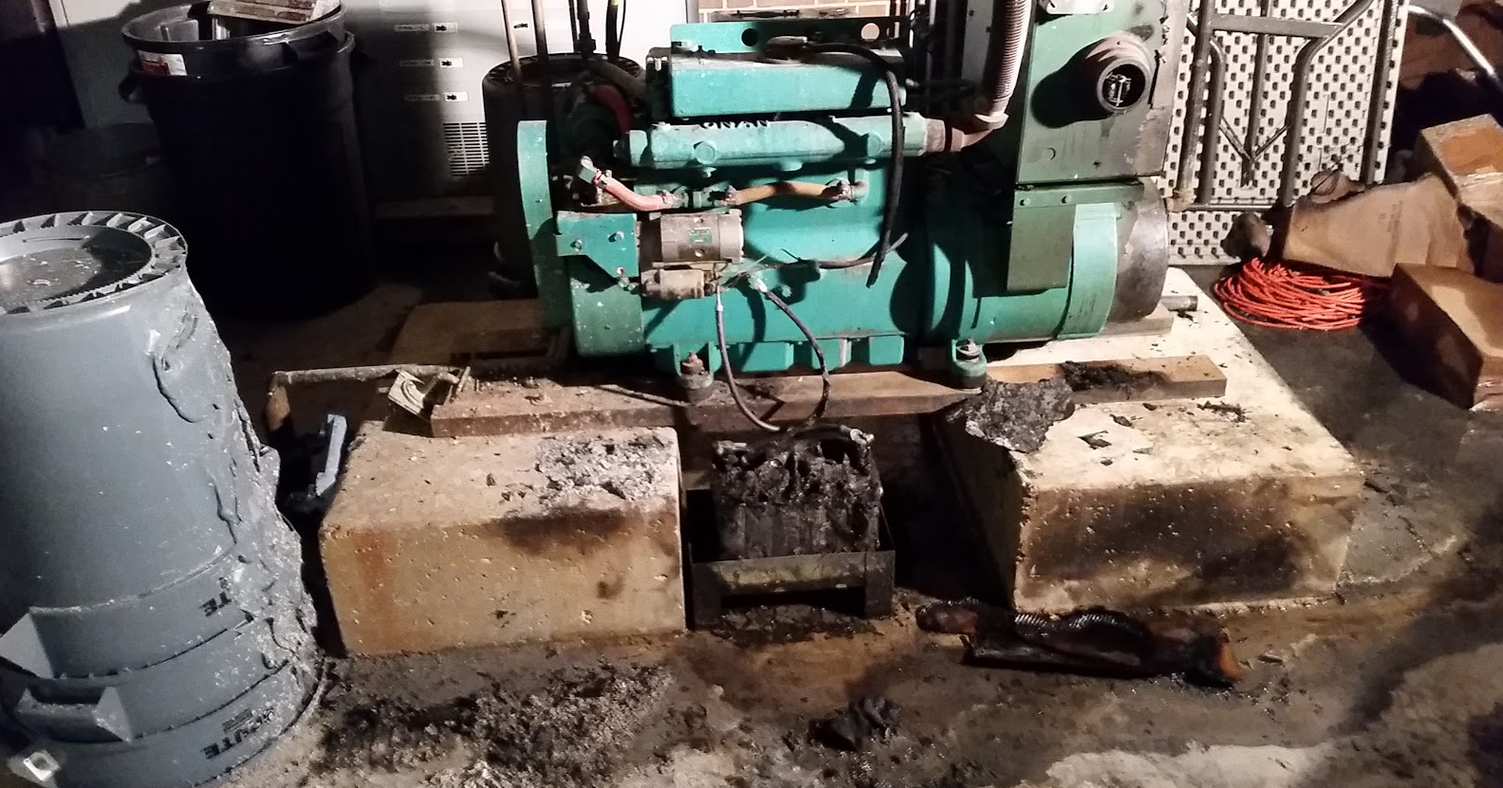
July 20, 2015
Barrie Elementary 8:00 am

Slide 11
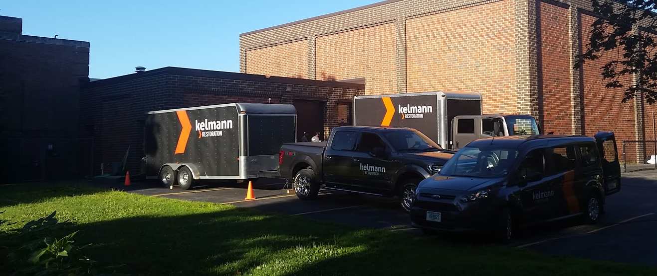
July 20, 2015
Barrie Elementary 1:00 pm

Slide 12
July 20, 2015
Barrie Fire
No Delay in School / Registration at Luther
Every Inch of Surface on Main Floor Cleaned
All Air Scrubbed
All Ducts Cleaned
Fiber Replaced
Wiring / Lights Replaced in Room

Slide 13
July 20, 2015 cont.
Some HVAC Controls / Electric Switches Replaced
Air Clearance Before Persons in Building (EMC) August 8th & 19th
New Generator will be Installed
Currently Have a Temporary Back-Up
All Loose Contents in Generator Room a Loss

Slide 14
Thank You, Contact Info
Tom Kulczewski
School District of Fort Atkinson
Director of Buildings and Grounds
201 Park Street
Fort Atkinson, WI 53538
920-563-7808
tomk@fortschools.org

